Slide 1
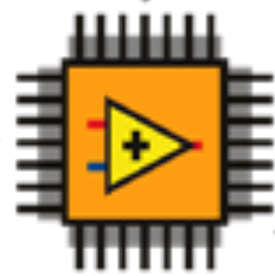
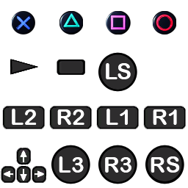
a_x
a_y
a_z
p
q
r
= Custom Device
IMU
= FPGA
ctrl_custom
X
Y
Psi
ctrl_DP
Oqus
PosXLeft
PosYLeft
PosXRight
PosYRight
R2
L2
ArrowUp
ArrowDown
Start
u_BT
u_VSP1
u_VSP2
alpha_VSP1
alpha_VSP2
omega_VSP1
omega_VSP2
ctrl_sixaxis2thruster
WL_Joystick
u2pwm
PWM
STOP
Triangle
Square
Cross
Circle
Triangle
Square
Cross
Circle

